Slide 1

Team Big Data:
Sai ram Koppusetti
Nishad amreen
Bharath Kumar
Ankit

Slide 2

Big data is a term applied to data sets whose size is beyond the ability of commonly used software tools to capture, manage, and process the data within a time.
Sources : Web logs; RFID; sensor networks; social networks; social data; Internet text/Index; call detail records; astronomy, atmospheric science, biological; military surveillance; medical records; photography & video archives

Slide 3
5 v’s of Big Data
Volume: refers to the vast amount of data generated every second.
Velocity: refers to the speed at which new data is generated and speed at which data moves around.
variety: refers to the different types of data we can now use. Structured, unstructured and semi-structured data used now a days.
Veracity: refers to the trustworthiness of the data, with many forms of data quality and accuracy are less controllable.
value: this refers to our ability to turn our data into value. It is important for businesses fro any attempt to collect and leverage big data.

Slide 4
FACTS ABOUT BIG DATA
More than 90% of all the data in the globe was generated over the course of past two years.
The total volume of data that the industry captures and stores, gets doubled in every 1.2 years.
Twitter processes 340 million messages .
Facebook generates 2.7 billion comments and likes.
Approximately, 100 hours of video are uploaded to video platforms like YouTube, every minute.

Slide 5
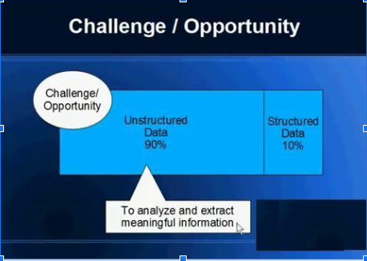
Problems with data

Slide 6
Challenges of Big Data
Recognizing the unstructured data. Ex: pdf, web pages, videos etc.
Storing big data in right time
Processing the big data
Analyzing the big data
Using the analyzed data in productive manner in right time and deliver to right people

Slide 7
HADOOP

Slide 8

What is Hadoop?
The Apache Hadoop software library is a framework that allows for the distributed processing of large data sets across clusters of computers using simple programming models.
It is made by apache software foundation in 2011.
Written in JAVA.

Slide 9
Hadoop is open source software.
Framework
Massive Storage
Processing Power

Slide 10
So what is the problem??
1. Processing that large data is very difficult in relational database.
2. It would take too much time to process data and cost.

Slide 11
We can solve this problem by Distributed Computing.
But the problems in distributed computing is –
Hardware failure
Chances of hardware failure is always there.
Combine the data after analysis
Data from all disks have to be combined from all the disks which is a mess.

Slide 12
To Solve all the Problems Hadoop Came.
It has two main parts –
Hadoop Distributed File System (HDFS),
Data Processing Framework & MapReduce

Slide 13
Hadoop Features
Hadoop provides access to the file systems.
The Hadoop Common package contains the necessary JAR files and scripts.
The package also provides source code, documentation and a contribution section that includes projects from the Hadoop Community.

Slide 14
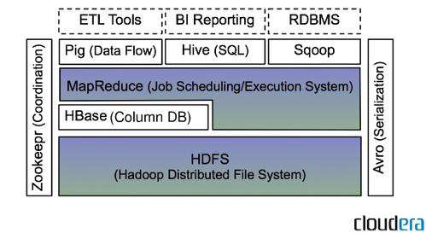
HADOOP ARCHITECTURE

Slide 15
1. Hadoop Distributed File System
It ties so many small and reasonable priced machines together into a single cost effective computer cluster.
Data and application processing are protected against hardware failure.
If a node goes down, jobs are automatically redirected to other nodes to make sure the distributed computing does not fail.
it automatically stores multiple copies of all data.
It provides simplified programming model which allows user to quickly read and write the distributed system.

Slide 16
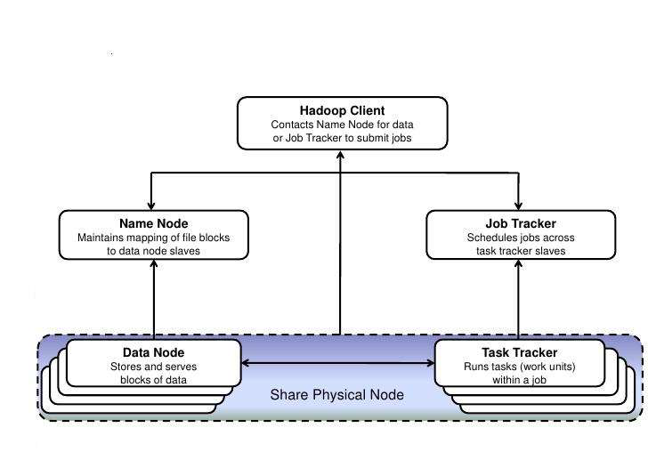
Hadoop High Level Architechture

Slide 17
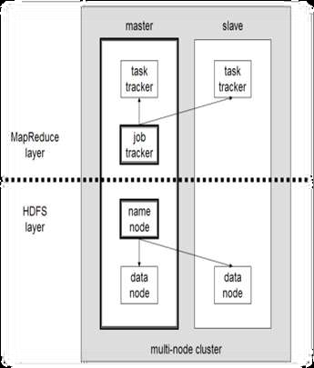
Hadoop cluster
•A Small Hadoop Cluster Include a single master & multiple worker nodes.
Master node:
Data Node Slave node:
Job Tracker Data Node
Task Tracker Task Tracker
Name Node

Slide 18
HDFS – Name Node Features
Metadata in main memory:
List of files
List of blocks for each file
List of Data Nodes for each block
File attributes
Creation time
Records every change in the metadata

Slide 19
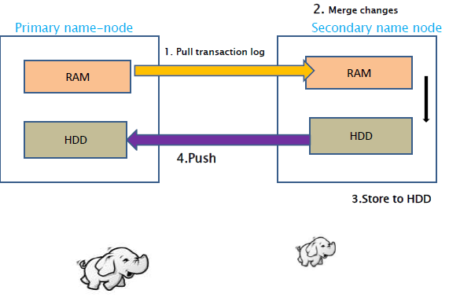
HDFS-name node architecture

Slide 20

HDFS-Data node
Block Server Stores data in the local file system
Periodic validation of checksums
Periodically sends a report of all existing blocks to the Name Node

Slide 21
2. MapReduce
MapReduce is a programming model for processing and generating large data sets with a parallel, distributed algorithm on a cluster.
Further explained well by Sairam

Slide 22
Pros of Hadoop
Computing power
Flexibility
Fault Tolerance
Low Cost
Scalability

Slide 23
Cons of Hadoop
Integration with existing systems
Hadoop is not optimised for ease for use. Installing and integrating with existing databases might prove to be difficult, especially since there is no software support provided.
Administration and ease of use
Hadoop requires knowledge of MapReduce, while most data practitioners use SQL. This means significant training may be required to administer Hadoop clusters.
Security
Hadoop lacks the level of security functionality needed for safe enterprise deployment, especially if it concerns sensitive data.

Slide 24
MAP REDUCE

Slide 25
Before Map-Reduce
Large scale data processing was difficult.
Managing hundreds or thousands of processors.
I/O scheduling.
Map-reduce provides all of these easily….

Slide 26
Overview of Map Reduce
Hadoop Map-Reduce is a software framework for easily writing application which process vast enormous amount of data in-parallel on large clusters of commodity hardware in a reliable way.
This is a programming model used by google.
A combination of Map and Reduce models with an associated implementation.
Map-reduce is highly scalable and can be used across many and answers all problems mentioned earlier.
Many small machines can be used to process jobs that normally could not be processed by a large machine.
Programming languages supported: Java

Slide 27
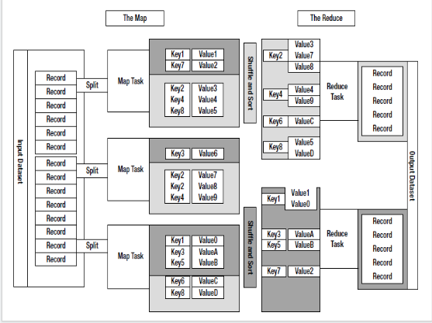

Slide 28
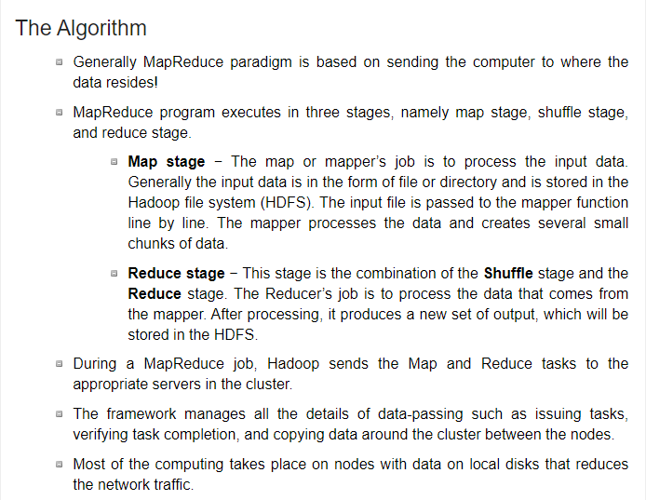

Slide 29
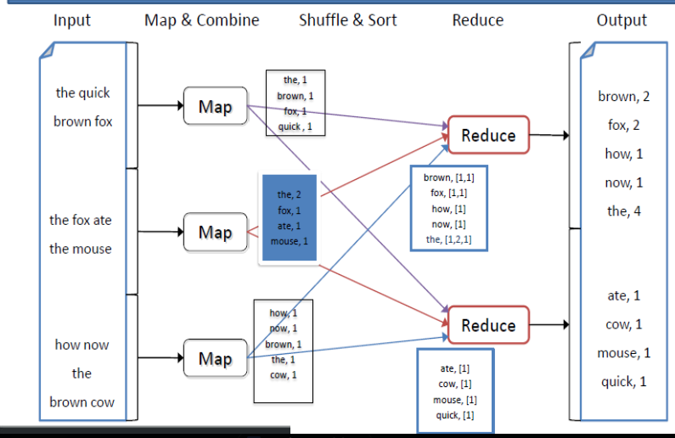
Word count solution using Map Reduce

Slide 30
Standard Map Reduce i/p and o/p
Mappers i/p Reducer i/p
0,My Name is Khan My,[1,1]
15,My Random Random Random,[1,1,1]
31,Big data Random Data[1]
Mappers o/p Reducer o/p
My,1 My[2]
Name,1 Random[3]
Is,1
My,1 Data[1]

Slide 31
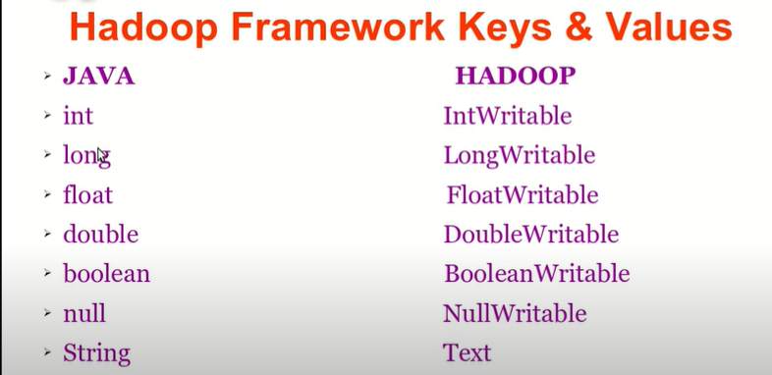
Java Data Types vs Hadoop Data Types

Slide 32
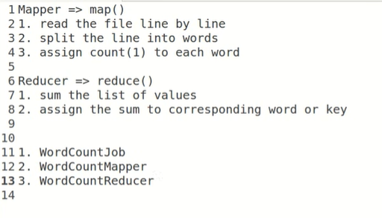
Lets jump into Code now.

Slide 33
Run the Map Reduce
Create a txt file
Create a HDFS directory(hadoop fs –mkdir foldername)
Copy the files/folders from local file system to hdfs store
(hadoop fs –put demo.txt foldername)
Run the code and the syntax is below
Hadoop Jar Jarfilelocation.jar Inputdir Outputdir
Open file in output directory and we see the results there

Slide 34
Hadoop data Base (HBase):
Why we need Hbase:
HBase is a NoSQL, column-oriented database built on top of Hadoop to overcome the drawbacks of HDFS as it allows fast random writes and reads in an optimized way. Also, with exponentially growing data, relational databases cannot handle the variety of data to render better performance. HBase provides scalability and partitioning for efficient storage and retrieval.
What is Hbase:
HBase is a distributed column-oriented database built on top of the Hadoop file system. It is an open-source project and is linearly scalable.
HBase is a data model that is designed to provide quick random access to huge amounts of structured data. It leverages the fault tolerance provided by the Hadoop File System (HDFS).
It is a part of the Hadoop ecosystem that provides random real-time read/write access to data in the Hadoop File System.

Slide 35
HDFS | HBase
HDFS is a distributed file system suitable for storing large files. | HBase is a database built on top of the HDFS.
HDFS does not support fast individual record lookups. | HBase provides fast lookups for larger tables.
It provides high latency batch processing; no concept of batch processing. | It provides low latency access to single rows from billions of records (Random access).
It provides only sequential access of data. | HBase internally uses Hash tables and provides random access, and it stores the data in indexed HDFS files for faster lookups.
HBase and HDFS

Slide 36
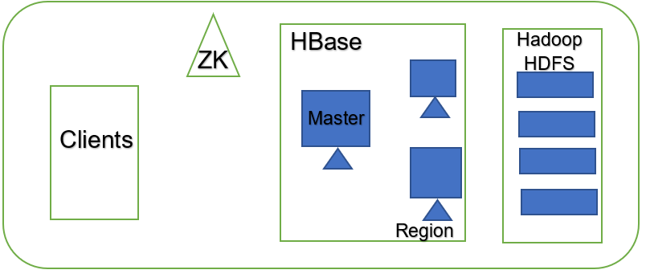
HBase sits on top of the Hadoop File System and provides read and write access. we can store the data in HDFS either directly or through HBase. clients reads/accesses the data in HDFS randomly using HBase.

Slide 37
HBase has three major components: the client library, a master server, and region servers.
MasterServer -
It Assigns regions to the region servers and takes the help of Apache ZooKeeper for this task.
Handles load balancing of the regions across region servers. It unloads the busy servers and shifts the regions to less occupied servers.
Maintains the state of the cluster by negotiating the load balancing.
Is responsible for schema changes and other metadata operations such as creation of tables and column families.
Regions -
Regions are nothing but tables that are split up and spread across the region servers.
Region server -
Communicate with the client and handle data-related operations.
Handle read and write requests for all the regions under it.
Decide the size of the region by following the region size thresholds.

Slide 38
Zookeeper -
Zookeeper is an open-source project that provides services like maintaining configuration information, naming, providing distributed synchronization, etc.
Zookeeper has ephemeral nodes representing different region servers. Master servers use these nodes to discover available servers.
In addition to availability, the nodes are also used to track server failures or network partitions.
Clients communicate with region servers via zookeeper.
Storage Mechanism in HBase
HBase is a column-oriented database and the tables in it are sorted by row. The table schema defines only column families, which are the key value pairs. A table have multiple column families and each column family can have any number of columns. Subsequent column values are stored contiguously on the disk. Each cell value of the table has a timestamp.

Slide 39
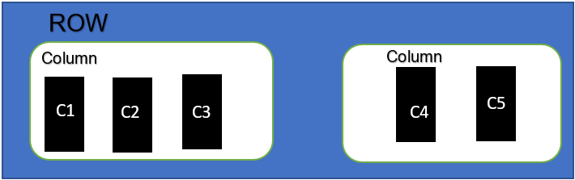
Row Key | Personal info |  | College Info
Student ID | Name | cell | Course | Enrol year
1 | Ankit | 223 | Bigdata | 2019S
2 | Bharath | 224 | cloud | 2019W
3 | Nishad | 225 | CCBT | 2020S
4 | SaiRam | 226 | Java | 2020W

Slide 40
HBase | RDBMS
HBase is schema-less, it doesn't have the concept of fixed columns schema; defines only column families. | An RDBMS is governed by its schema, which describes the whole structure of tables.
It is built for wide tables. HBase is horizontally scalable. | It is thin and built for small tables. Hard to scale.
No transactions are there in HBase. | RDBMS is transactional.
It has de-normalized data. | It will have normalized data.
It is good for semi-structured as well as structured data. | It is good for structured data.
HBase and RDBMS

Slide 41
Features of HBase
HBase is linearly scalable.
It has automatic failure support.
It provides consistent read and writes.
It integrates with Hadoop, both as a source and a destination.
It has easy java API for client.
It provides data replication across clusters.
Where we can use HBase
It is used whenever there is a need to write heavy applications.
HBase is used whenever we need to provide fast random access to available data.
Companies such as Facebook, Twitter, Yahoo, and Adobe use HBase internally.

Slide 42

HIVE
Ankit Sharma
C-0770025

Slide 43
What is Hive?
Hive is a data warehouse infrastructure tool to process structure data in Hadoop. It resides on top of Hadoop to summarize Big Data, and makes querying and analyzing easy.
Initially Hive was developed by Facebook, later the Apache Software Foundation took it up and developed it further as an open source under the name Apache Hive.

Slide 44
Features of Hive
It stores Schema in a database and processed data into HDFS(Hadoop Distributed File System).
It is designed for OLAP.
It provides SQL type language for querying called HiveQL or HQL.
It is familiar, fast, scalable, and extensible.

Slide 45
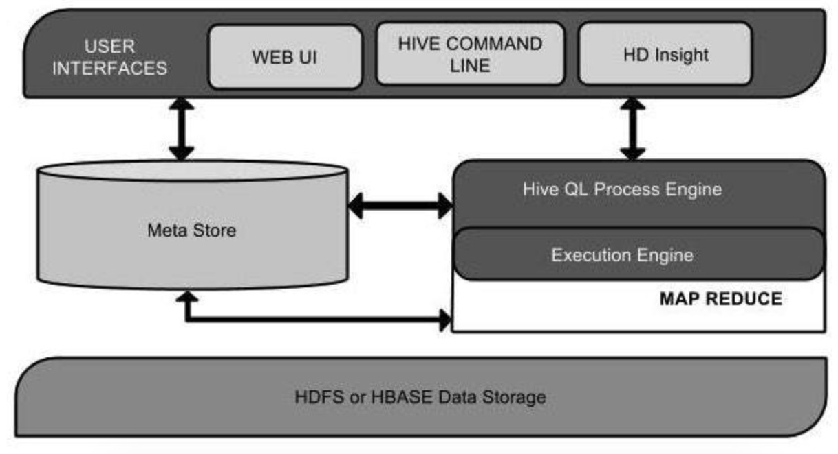
Architecture of Hive

Slide 46
Architecture of Hive
User Interface - Hive is a data warehouse infrastructure software that can create interaction between user and HDFS. The user interfaces that Hive supports are Hive Web UI, Hive command line, and Hive HD.
Meta Store -Hive chooses respective database servers to store the schema or Metadata of tables, databases, columns in a table, their data types and HDFS mapping.
HiveQL Process Engine- HiveQL is similar to SQL for querying on schema info on the Megastore. It is one of the replacements of traditional approach for MapReduce program. Instead of writing MapReduce program in Java, we can write a query for MapReduce job and process it.

Slide 47
Execution Engine - The conjunction part of HiveQL process Engine and MapReduce is Hive Execution Engine. Execution engine processes the query and generates results as same as MapReduce results. It uses the flavor of MapReduce.
HDFS or HBASE - Hadoop distributed file system or HBASE are the data storage techniques to store data into the file system.

Slide 48
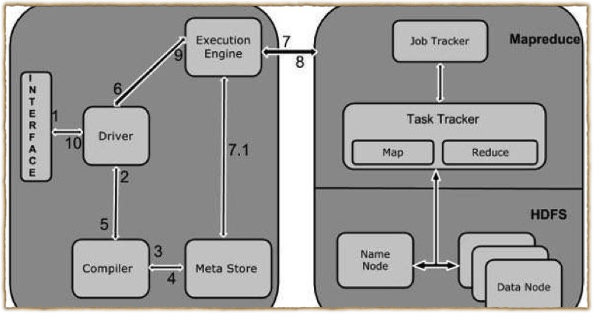
Working of Hive

Slide 49
Working of Hive
Execute Query- The Hive interface such as Command Line or Web UI sends query Driver to execute.
Get Plan- The driver takes the help of query complier that parses the query to check the syntax and query plan or the requirement of query.
Get Metadata- The compiler sends metadata request to Megastore
Send Metadata- Metastore sends metadata as a response to the compiler.

Slide 50
Send Plan- The compiler checks the requirement and resends the plan to the driver. Up to here, the parsing and compiling of a query is complete.
Execute Plan- the driver sends the execute plan to the execution engine.
Execute Job- Internally, the process of execution job is a MapReduce job. The execution engine sends the job to JobTracker, which is in Name node and it assigns this job to TaskTracker, which is in Data node. Here, the query executes MapReduce job.

Slide 51
Metadata Ops- Meanwhile in execution, the execution engine can execute metadata operations with Metastore.
Fetch Result- The execution engine receives the results from Data nodes.
Send Results- The execution engine sends those resultant values to the driver.
Send Results- The driver sends the results to Hive Interfaces.

Slide 52
Hive- Data Types
All the data types in hive are classified into four types
Column Types Literals
Null Values Complex Types

Slide 53
Column Types
Integral Types - Integer type data can be specified using integral data types, INT. When the data range exceeds the range of INT, you need to use BIGINT and if the data range is smaller than the INT, you use SMALLINT. TINYINT is smaller than SMALLINT.
String Types - String type data types can be specified using single quotes (' ') or double quotes (" "). It contains two data types: VARCHAR and CHAR. Hive follows C-types escape characters.

Slide 54

Timestamp - It supports traditional UNIX timestamp with optional nanosecond precision. It supports java.sql.Timestamp format “YYYY-MM-DD HH:MM:SS.fffffffff” and format “yyyy-mm- dd hh:mm:ss.ffffffffff”.
Dates - DATE values are described in year/month/day format in the form {{YYYY-MM-DD}}.
Decimals -The DECIMAL type in Hive is as same as Big Decimal format of Java. It is used for representing immutable arbitrary precision.
Union Types - Union is a collection of heterogeneous data types. You can create an instance using create union.

Slide 55
Literals
Floating Point Types - Floating point types are nothing but numbers with decimal points. Generally, this type of data is composed of DOUBLE data type.
Decimal Type - Decimal type data is nothing but floating point value with higher range than DOUBLE data type. The range of decimal type is approximately -10⁻³⁰⁸ to 10³⁰⁸.

Slide 56
Complex Types
Arrays - Arrays in Hive are used the same way they are used in Java.
Syntax: ARRAY<data_type>
Maps - Maps in Hive are similar to Java Maps.
Syntax: MAP<primitive_type, data_type>
Structs - Structs in Hive is similar to using complex data with comment.
Syntax: STRUCT<col_name : data_type [ COMMENT col_comment, … ]>

Slide 57
Create Database
hive> CREATE DATABASE [IF
NOT EXISTS] userdb;
hive> CREATE SCHEMA userdb; hive> SHOW DATABASES;

Slide 58
Drop Database
hive>DROP DATABASE [IF
EXISTS] userdb;
hive> DROP DATABASE [IF EXISTS] userdb CASCADE;
hive> DROP SCHEMA userdb;

Slide 59
Create Table
hive> CREATE TABLE IF NOT EXISTS
employee(eid int, name String, salary String, destination String)
>COMMENT ‘Employee details’
>ROW FORMAT DELIMITED
>FIELDS TERMINATED BY ‘\t’
>LINES TERMINATED BY ‘\n’
>STORED AS TEXTFILE;

Slide 60
Partition
Hive organizes tables into partitions. It is a way of dividing a table into related parts based on the values of partitioned columns such as date, city, and department. Using partition, it is easy to query a portion of the data.
Adding partition- Syntax - hive> ALTER TABLE employee ADD PARTITION(year =‘2013’) location ‘/2012/part2012’;
Dropping partition - Syntax - hive>ALTER TABLE employee DROP [IF EXISTS] PARTITION (year=‘2013’);

Slide 61
HiveQL - Select Where
The Hive Query Language (HiveQL) is a query language for Hive to process and analyze structured data in a Metastore.
hive> SELECT * FROM employee WHERE salary>30000;

Slide 62
HiveQL - Select Order By
The ORDER BY clause is used to retrieve the details based on one column and sort the result set by ascending or descending order.
hive> SELECT Id, Name, Dept FROM employee ORDER BY DEPT;

Slide 63
HiveQL - Select-Group By
The GROUP BY clause is used to group all the records in a result set using a particular collection column. It is used to query a group of records.
hive> SELECT Dept,count(*) FROM employee GROUP BY DEPT;

Slide 64
HiveQL - Select-Joins
JOIN is a clause that is used for combining specific fields from two tables by using values common to each one. It is used to combine records from two or more tables in the database. It is more or less similar to SQL JOIN.
There are different types of joins given as follows: JOIN
LEFT OUTER JOIN RIGHT OUTER JOIN FULL OUTER JOIN
•
•
•
•

Slide 65
JOIN
JOIN clause is used to combine and retrieve the records from multiple tables. JOIN is same as OUTER JOIN in SQL. A JOIN condition is to be raised using the primary keys and foreign keys of the tables.
hive> SELECT c.ID, c.NAME, c.AGE, o.AMOUNT FROM CUSTOMERS c JOIN ORDERS o ON (c.ID = o.CUSTOMER_ID);

Slide 66
Left Outer Join
The HiveQL LEFT OUTER JOIN returns all the rows from the left table, even if there are no matches in the right table. This means, if the ON clause matches 0 (zero) records in the right table, the JOIN still returns a row in the result, but with NULL in each column from the right table.
hive> SELECT c.ID, c.NAME, o.AMOUNT, o.DATE FROM CUSTOMERS c LEFT OUTER JOIN ORDERS o ON (c.ID = o.CUSTOMER_ID);

Slide 67
Right Outer Join
The HiveQL RIGHT OUTER JOIN returns all the rows from the right table, even if there are no matches in the left table. If the ON clause matches 0 (zero) records in the left table, the JOIN still returns a row in the result, but with NULL in each column from the left table.
hive> SELECT c.ID, c.NAME, o.AMOUNT, o.DATE FROM CUSTOMERS c RIGHT OUTER JOIN ORDERS o ON (c.ID = o.CUSTOMER_ID);

Slide 68
Full Outer Join
The HiveQL FULL OUTER JOIN combines the records of both the left and the right outer tables that fulfill the JOIN condition. The joined table contains either all the records from both the tables, or fills in NULL values for missing matches on either side.
hive> SELECT c.ID, c.NAME, o.AMOUNT, o.DATE FROM CUSTOMERS c FULL OUTER JOIN ORDERS o ON (c.ID = o.CUSTOMER_ID);

Slide 69
Thank You

